Slide 1

Jesper Tjørnelund
CPHBusiness, Lyngby
2020-06-24

Slide 2
Start the project
Please open the ”Unity Hub” application and under Projects, open the sample project downloaded.
While it loads, here’s a short introduction

Slide 3










Popular game engine
Notes:
Some say worlds most popular game engine – primarily due to it’s ease of making crossplatform content.

Slide 4

What is it used for?

Slide 5
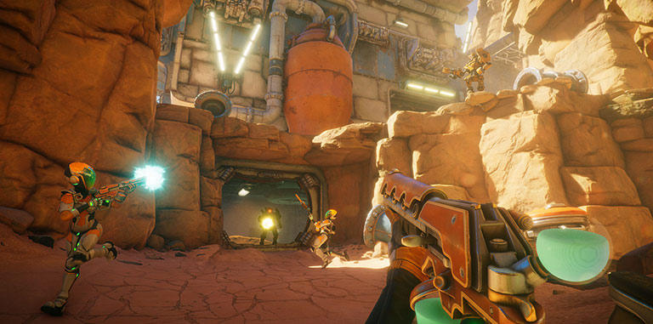


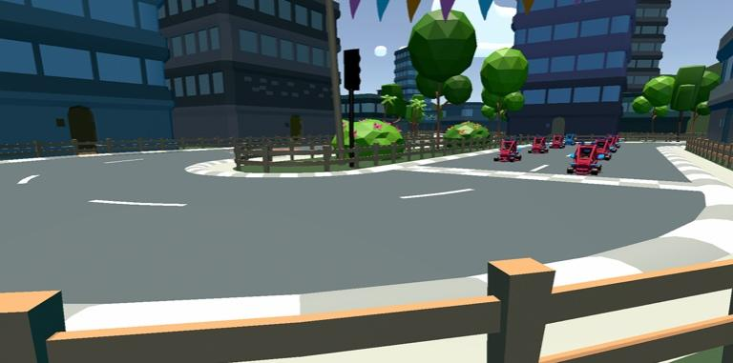








Games
Console and PC Games
Mobile Games
Instant Games
AR and VR Games
Notes:
Console and PC Games: Offering rich visual fidelity and artist-friendly tools, Unity delivers ultimate performance for your multi-threaded console and PC games.
Mobile games: Unity Mobile Games Development Platform is everything you need to create device-ready content, launch and monetize your mobile games.
Instant Games: With Unity, build instant games that are smaller, lighter and faster than ever before.
AR and VR Games: Our flexible real-time tools offer unlimited creative possibilities – powering more than 60% of all VR/AR content.

Slide 6
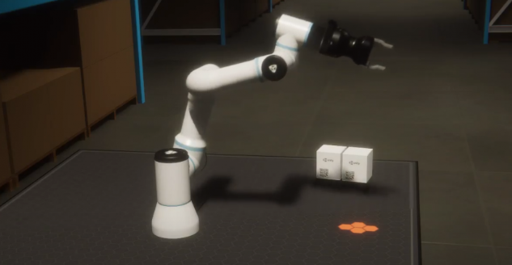
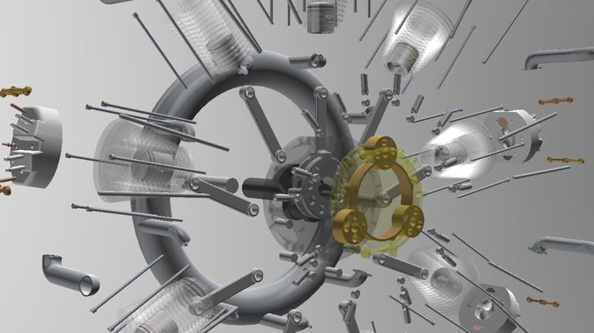
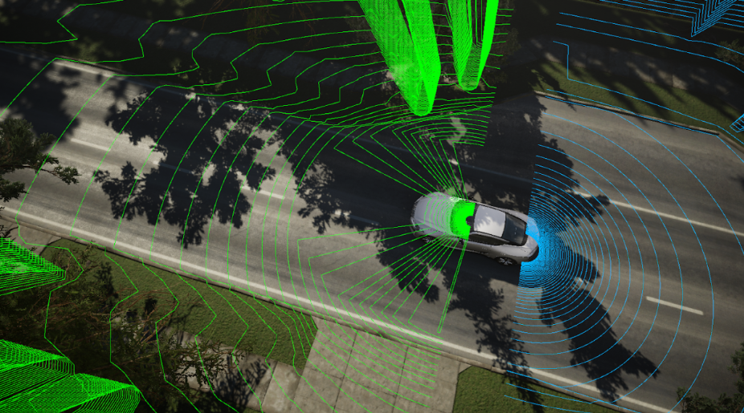
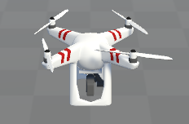
automotive transportation and manufacturing
Top: Simulating physics in robotics tasks
Middle: Showcase image for instructional project to automotive manufacturing
Bottom: Teach autonomous vehicle / drones to navigate in simulated environment
Notes:
Billeder:
Autonomous Vehicle Training – omgivelser brugt til at træne selvkørende biler

Slide 7

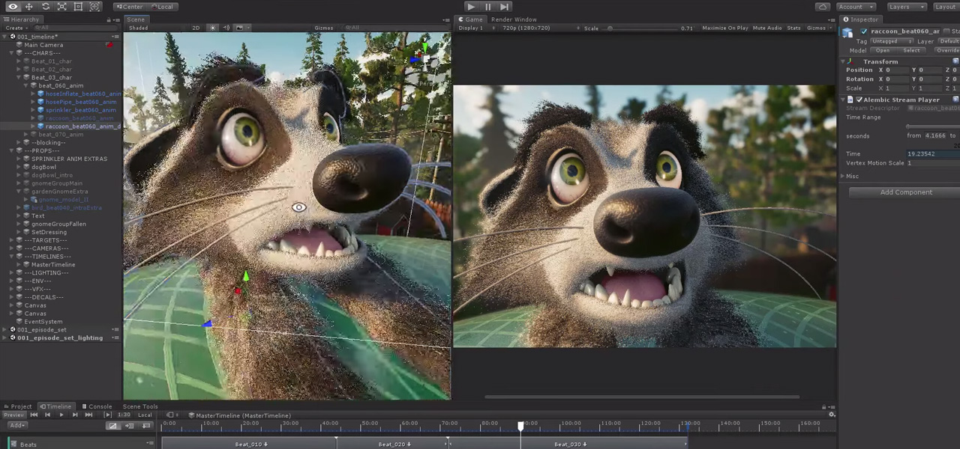
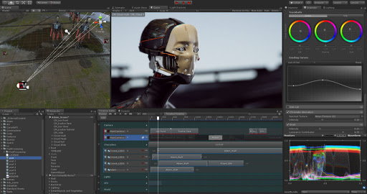
Film, Animation and cinematics
Can be used for in-game/app cinematics or instruction videos.
Can also create entire films.
Real time production through Unity Core Platform
More info: https://unity.com/solutions/film-animation-cinematics
Youtube search ”Unity Short film”

Slide 8


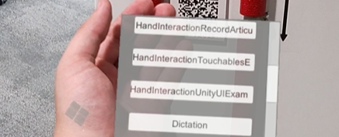
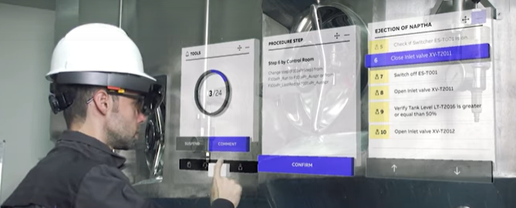
Architecture, Engineering & Construction
Top: Visualization of building prior to construction
Upper Middle: Photorealistic VR experience used for interior designs
Lower Middle: Demo and study of AR interfaces
Bottom: ABB Ability™ - control systems and real-time data capture.

Slide 9
Thank you for listening
Slides, resources for today’s lecture can be found at: http://tjorne.dk/cphbusiness_demo.zip

